Slide 1
Ami group 1 assignment
Flow charts

Slide 2
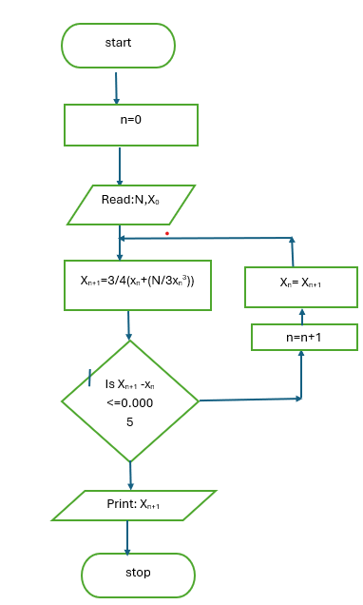
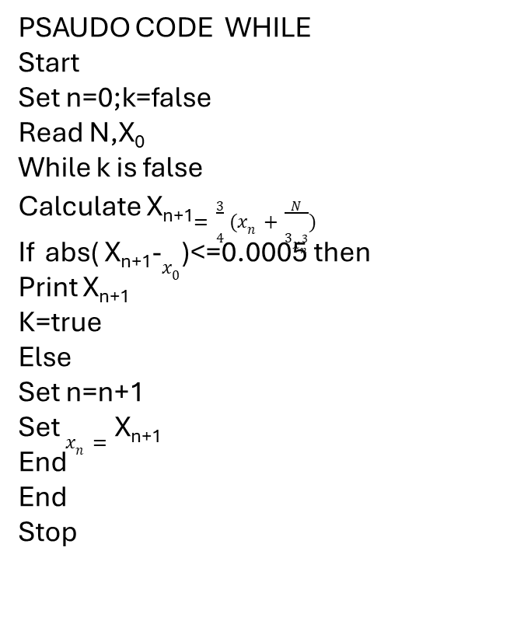
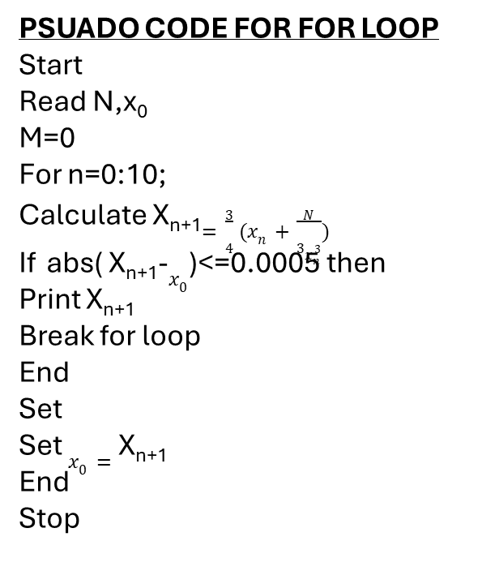
PSAUDO CODE WHILE
Start
Set n=0;k=false
Read N,X₀
While k is false
Calculate X_{n+1}$=\frac{3}{4}(x_{n}+\frac{N}{3x_{n}^{3}})$
If abs( X_{n+1}-$x_{0}$)<=0.0005 then
Print X_{n+1}
K=true
Else
Set n=n+1
Set $x_{n}=$ X_{n+1}
End
End
Stop
PSUADO CODE FOR FOR LOOP
Start
Read N,x₀
M=0
For n=0:10;
Calculate X_{n+1}$=\frac{3}{4}(x_{n}+\frac{N}{3x_{n}^{3}})$
If abs( X_{n+1}-$x_{0}$)<=0.0005 then
Print X_{n+1}
Break for loop
End
Set
Set $x_{0}=$ X_{n+1}
End
Stop

Slide 3
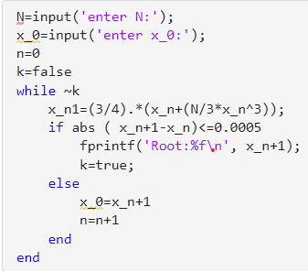
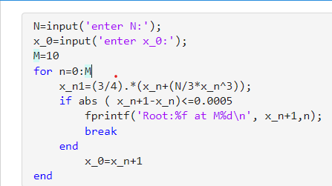

Slide 4
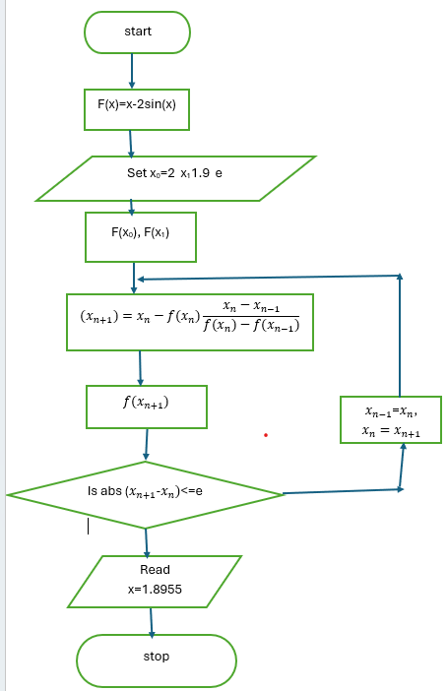
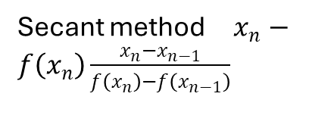
Secant method $x_{n}−f\left(x_{n}\right)\frac{x_{n}−x_{n−1}}{f\left(x_{n}\right)−f\left(x_{n−1}\right)}$
PSEUDO CODE FOR WHILE LOOP
START
Define f(x) = x - 2sin(x)
Set x₀ = 2
Set x₁= 1.9
Set tolerance = 0.00001
WHILE |x₁ – x₀| >= tolerance
F(0 )= f(x₀)
F(1) = f(x₁)
calculate X_{n+1}
X₀ = x₁
X₁ = x₂
END WHILE
Display "Positive root = ", x₁
STOP
PSEUDO CODE FOR LOOP
Define f(x) = x - 2sin(x)
Set x₀= 2
Set x₁= 1.9
Set tolerance = 0.00001
FOR i = 1 TO 10
F(0) = f(x₀)
F(1) = f(x₁)
calculate X_{n+1}
IF |x2 - x1| < tolerance THEN
BREAK the loop
END IF
X₀ = x₁
X₁ = x₂
END FOR
Display "Positive root = ", x₂
STOP

Slide 5
clc;
clear;
% Define the function
f = x - 2*sin(x);
% Initial values
X_0= 2;
X_1= 1.9;
Tolerance
e= 0.00001;
% Maximum number of iterations
for i = 1:10
% Calculate function values
F(0) = f(x_0);
f(1) = f(x_1);
% Secant formula
X_2 = x_1 - (f1*(x_1 - x_0))/(f(1)-f(0));
% Displaying iteration results
fprintf('Iteration %d: x = %.6f\n', i, x2);
clc;
clear;
f = x – 2*sin(x)
X_0= 2;
X_1= 1.9;
e= 0.00001;
p = 1;
while abs(x₁ – x₀) >= e
F(0 )= f(x₀);
F(1) = f(x₁);
% Secant formula
X₂ = x(1) – f(1 ).* (x₁ – x₀) / (f(1) – f(0))
fprintf('Iteration %d: x = %.6f\n', i, x₂ );
% adjust values
x_0 = x_1;
x_1 = x_2;
p= p+ 1;
end
fprintf('Root = %.6f\n', x₁);
% Check convergence
if abs(x2-x1) < tol
break;
end % Update values
x_0 = x_1;
x_1 = x_2;
end
fprintf('Positive root = %.6f\n', x2);

Slide 6
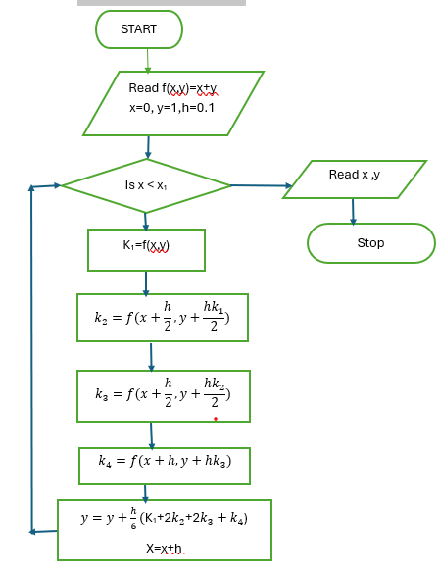
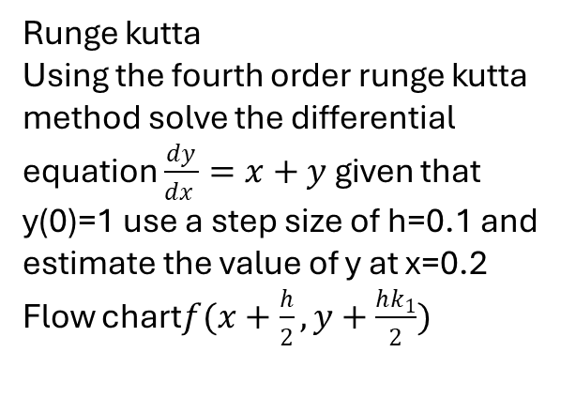
Runge kutta
Using the fourth order runge kutta method solve the differential equation $\frac{dy}{dx }=x+y$ given that y(0)=1 use a step size of h=0.1 and estimate the value of y at x=0.2
Flow chart$f(x+\frac{h}{2},y+\frac{hk_{1}}{2})$
PSAUDO CODE FOR WHILE LOOP
Start
Input the initial values of x ,y and x1
WHILE X<X1
k1 = f(x, y)
calculate k2 ,k3 and k4
calculate y and x
END the WHILE loop
Display x and y
STOP
PSAUDO CODE FOR LOOP
START
Input the initial values of x ,y and x1
Number of steps n = (x₁ - x)/h
FOR i = 1 TO n
k1 = f(x, y)
calculate k2 ,k3 and k4
calculate y and x
END the FOR loop
Display x and y
STOP

Slide 7
MATLAB CODE FOR FOR LOOP
clc;
clear;
% Setting the Initial values of x, y ,h and x1
x = 0;
y = 1;
h = 0.1;
x1 = 0.2;
% Number of steps
n = (x1 - x)/h;
% Runge kutta method
for i = 1:n
k1 = x + y;
k2 = (x + h/2) + (y + h*k1/2);
k3 = (x + h/2) + (y + h*k2/2);
k4 = (x + h) + (y + h*k3);
y = y + (h/6)*(k1 + 2*k2 + 2*k3 + k4);
x = x + h;
end
fprintf('At x = %.1f, y = %.6f\n', x, y);
MATLAB CODE FOR WHILE LOOP
clc;
clear;
% Setting the Initial values of x, y ,h and x1
x = 0;
y = 1;
h = 0.1;
x1 = 0.2;
% Runge kutta method
while x < x1
k1 = x + y;
k2 = (x + h/2) + (y + h*k1/2);
k3 = (x + h/2) + (y + h*k2/2);
k4 = (x + h) + (y + h*k3);
y = y + (h/6)*(k1 + 2*k2 + 2*k3 + k4);
x = x + h;
end
fprintf('At x = %.1f, y = %.6f\n', x, y);

